Slide 1
Lego Analysis
Portfolio Project
Vrushali Raodaskar

Slide 2
About
The LEGO Group was founded in 1932.
It is a global enterprise that is now one of the world’s largest manufacturers of toys with their most important product being the LEGO brick.
Lego has its products based on different themes and categories ranging from small to larger sets.

Slide 3
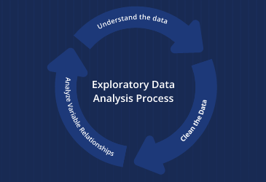
Objectives
Clean the data for highest quality information.
Investigating the dataset to discover patterns and form hypotheses based on our understanding of the dataset.
Create visualizations for better clarity.

Slide 4
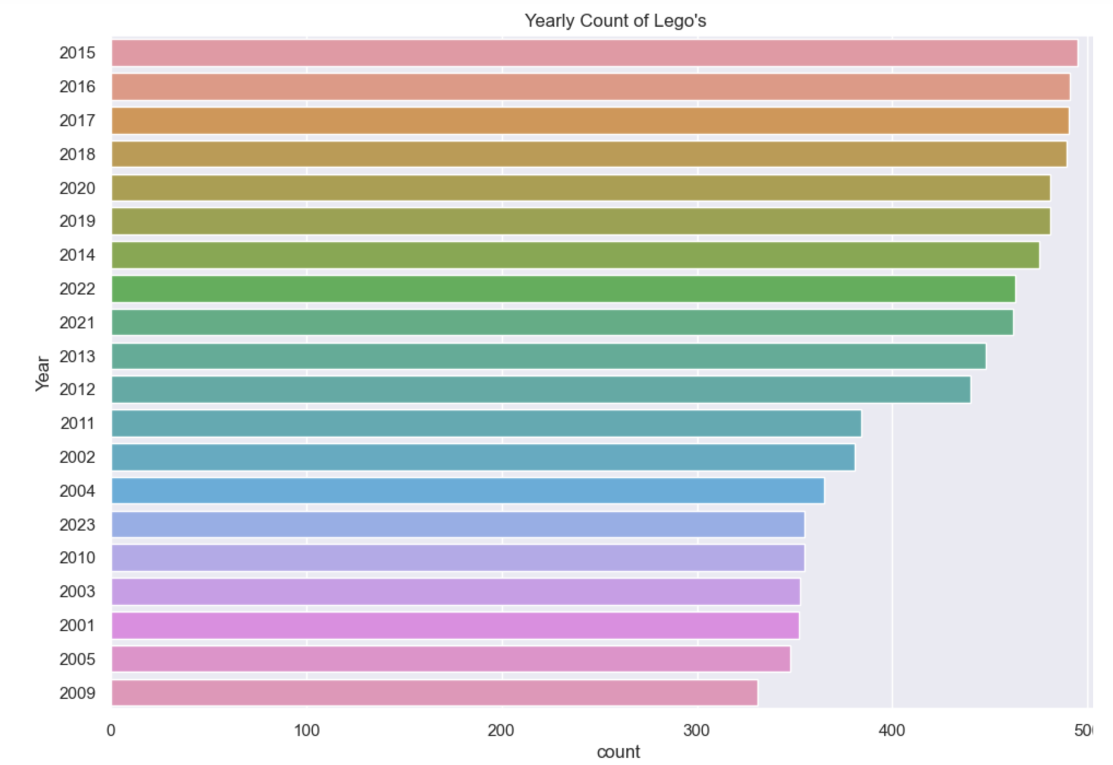
For the years considered from 2000 and onwards , the maximum number of Legos were made in the year 2015 and the minimum being 2009. In the recent few years the range has been average in terms of manufacturing.

Slide 5
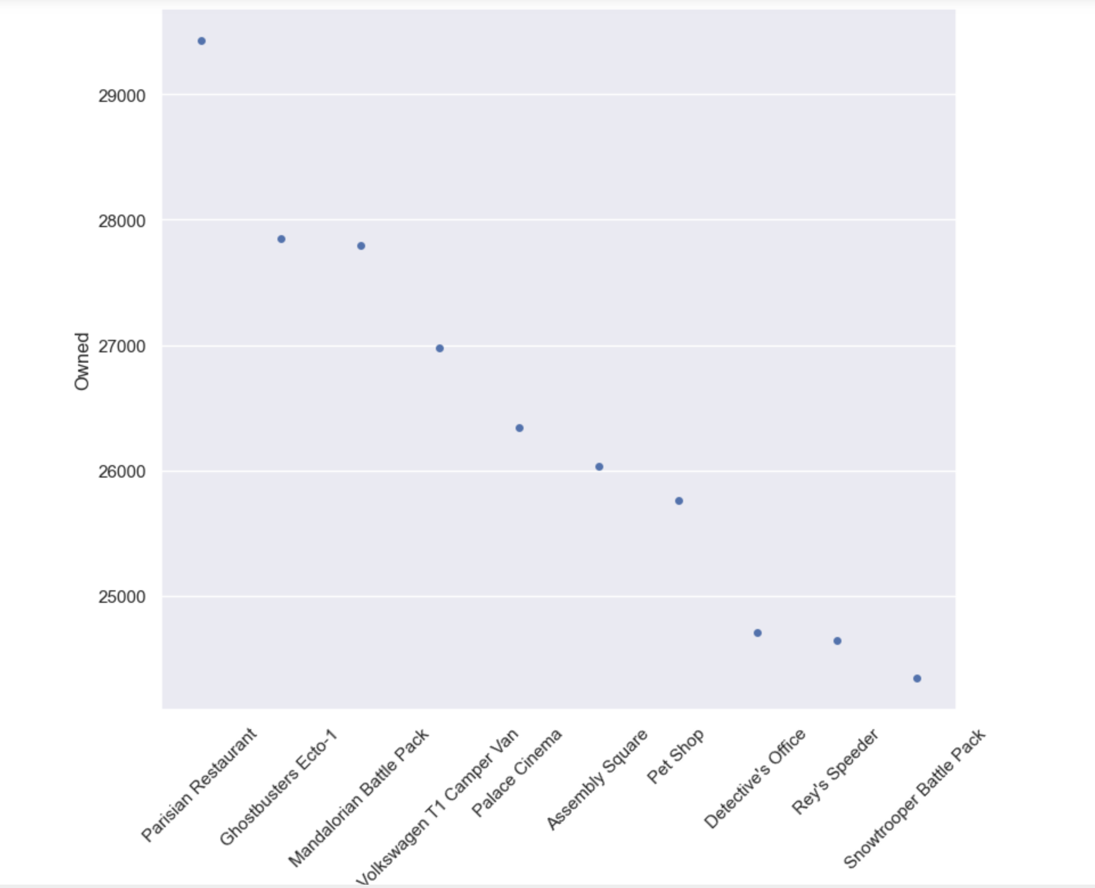
The most owned lego set has been Parisian Restaurant which was made in the year 2014 and comes under their Modular Buildings Collection. It’s a LEGO exclusive and a retired set now.

Slide 6
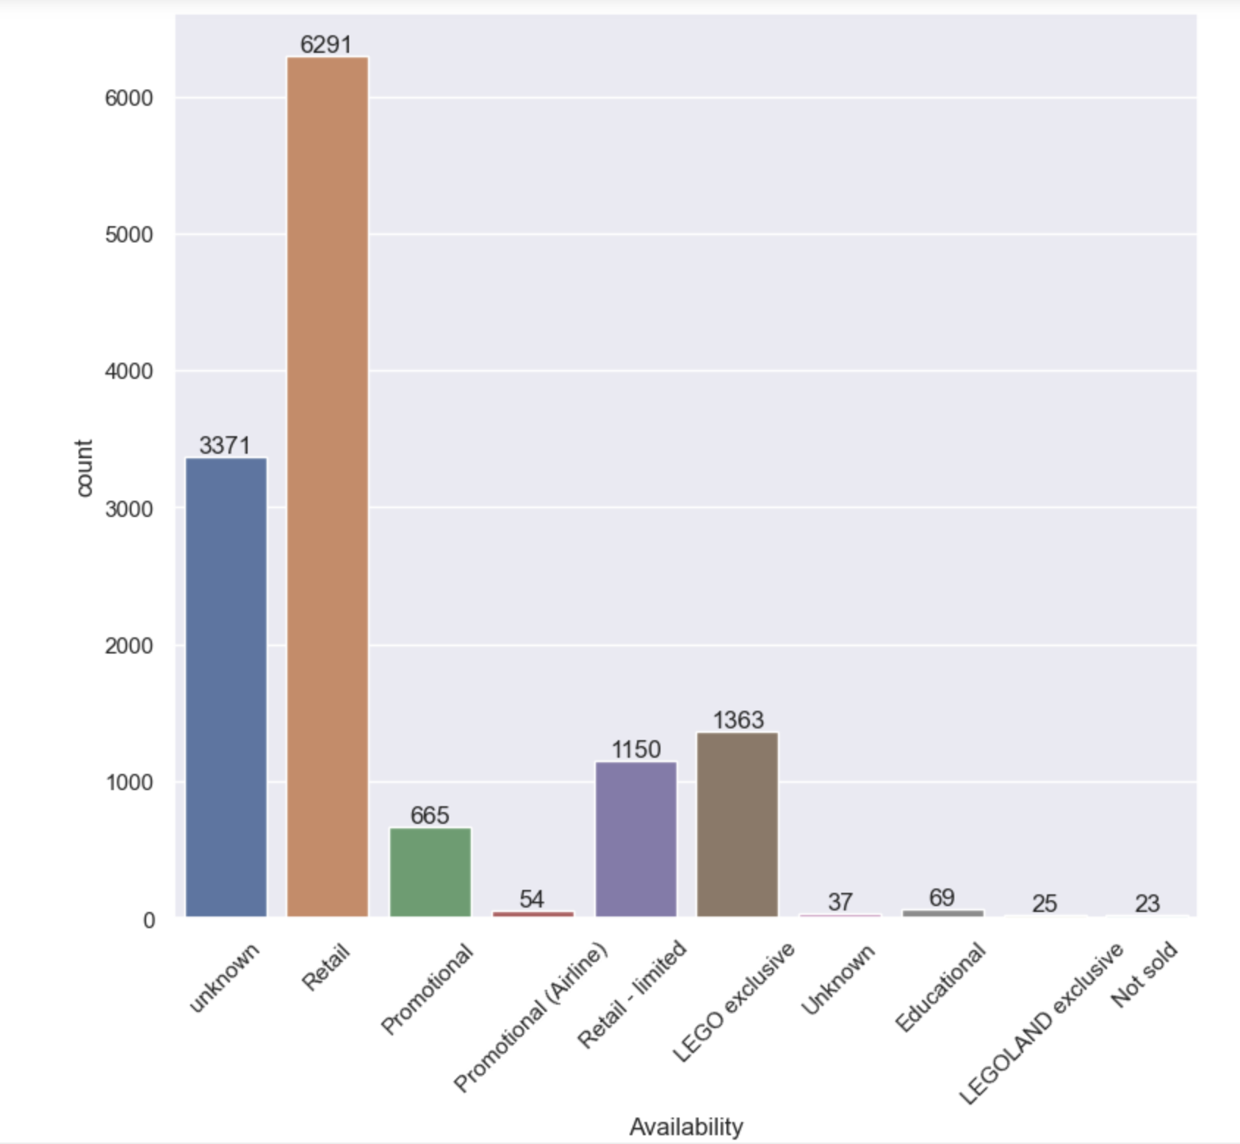
Lego has been doing well in the Retail sector with maximum sales whereas the other sectors are on lower end. Some of the lego sets remained unsold and can be discontinued.

Slide 7
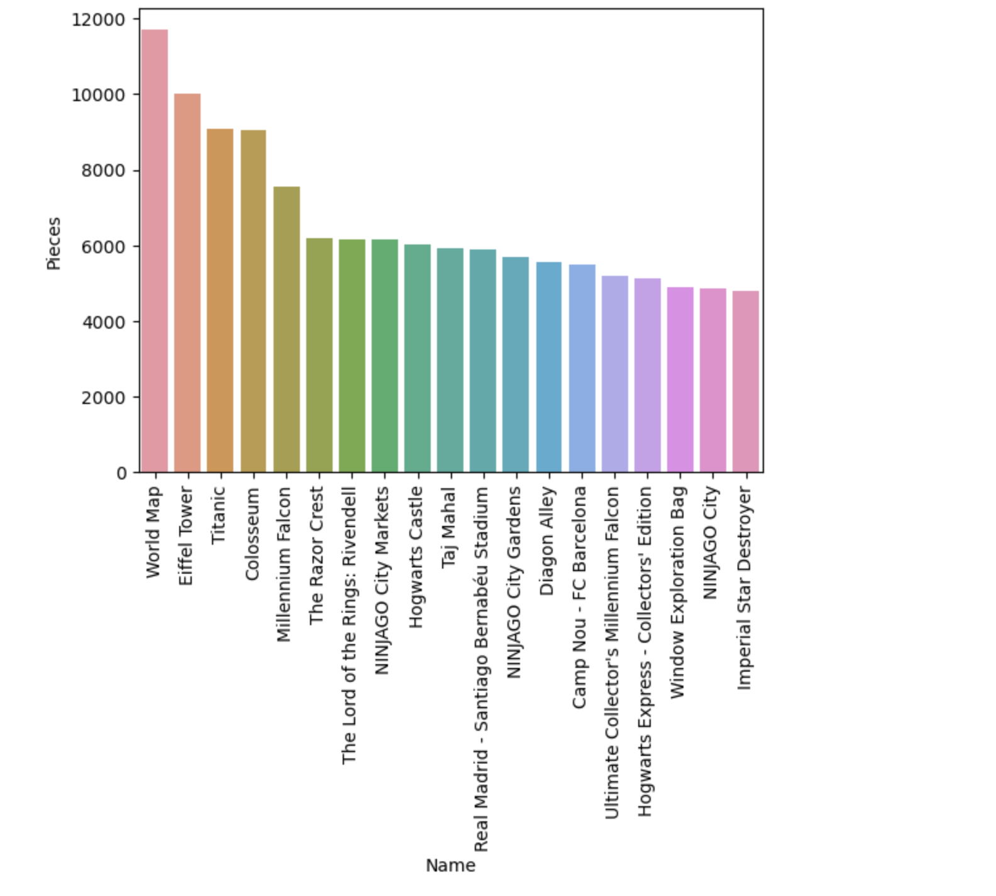
The set World Map set is huge and has 11695 number of pieces.

Slide 8
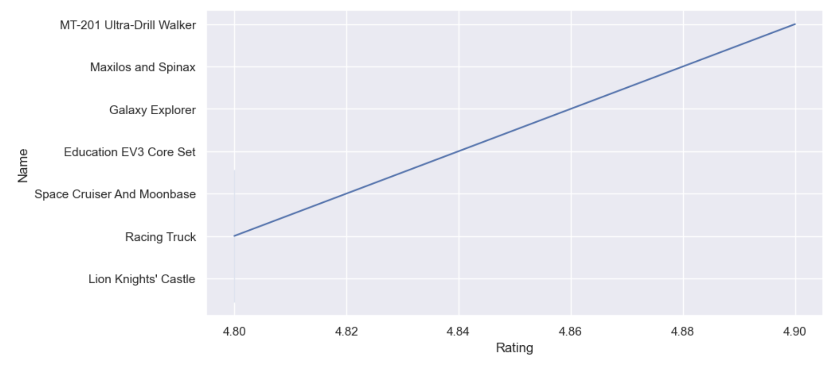
Highest rated lego set is MT-201 Ultra-Drill Walker with 4.90 rating.

Slide 9
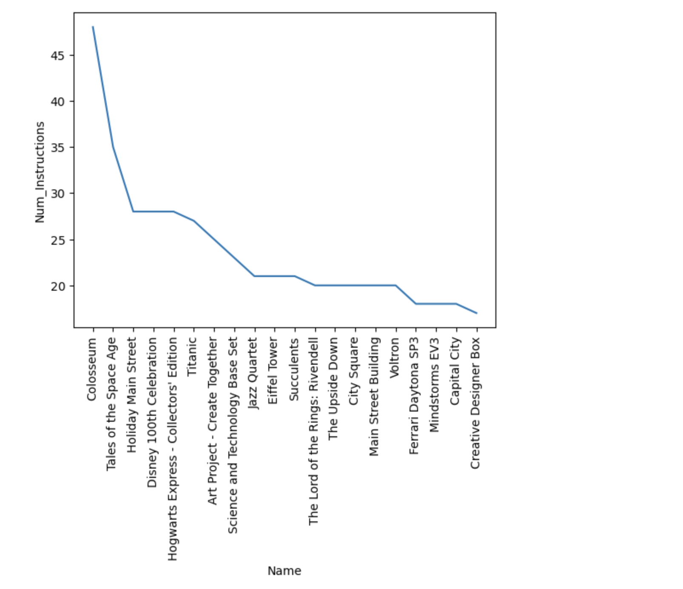
Colosseum has the maximum instruction booklets making it the largest ever set in lego

Slide 10
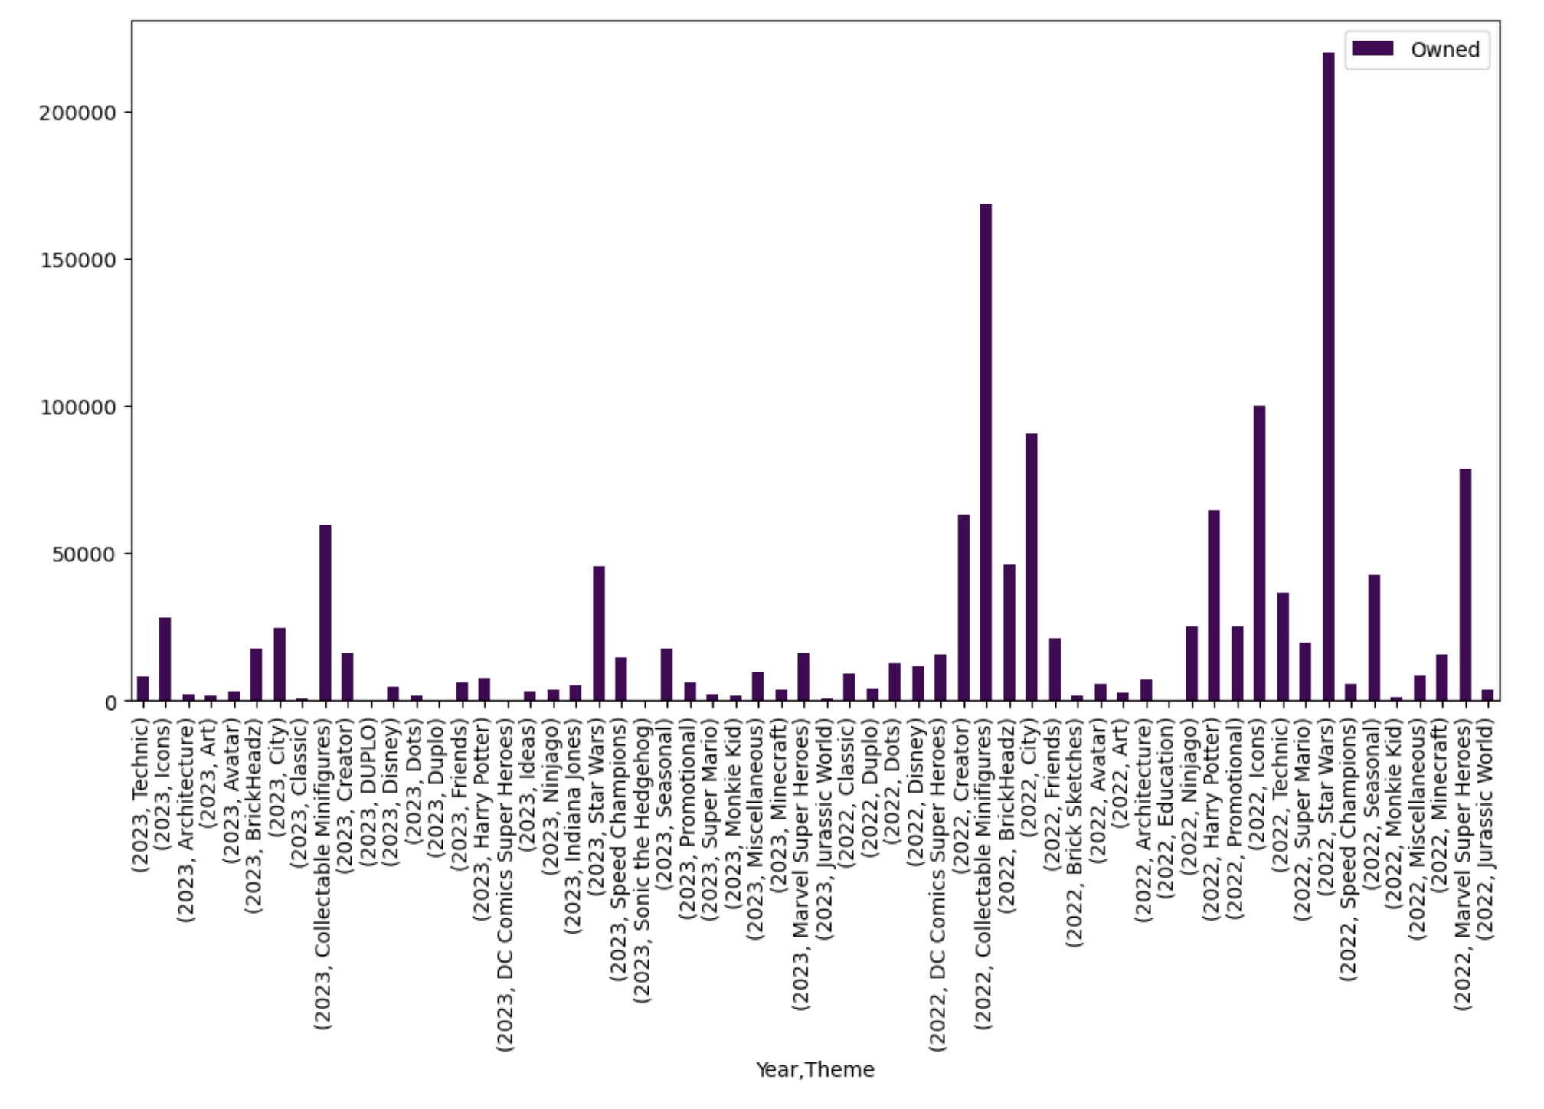
For recent years 2022 and 2023 collections from Star Wars and Collectible Minifigures are very popular

Slide 11
Findings
Lego has been a leader in toy manufacturing sector over the years and has expanded its range to various themes.
Some of the products are largely sold and appreciated by the customers and can give a base to create more sets accordingly.
Lego products are doing well in the Retail sector and can continue applying new strategies to grow further.
Products not being sold can be discontinued and efforts can be driven to other possibilities.
Star Wars and Minifigures collectibles have been the favourites in past two years.

Slide 12
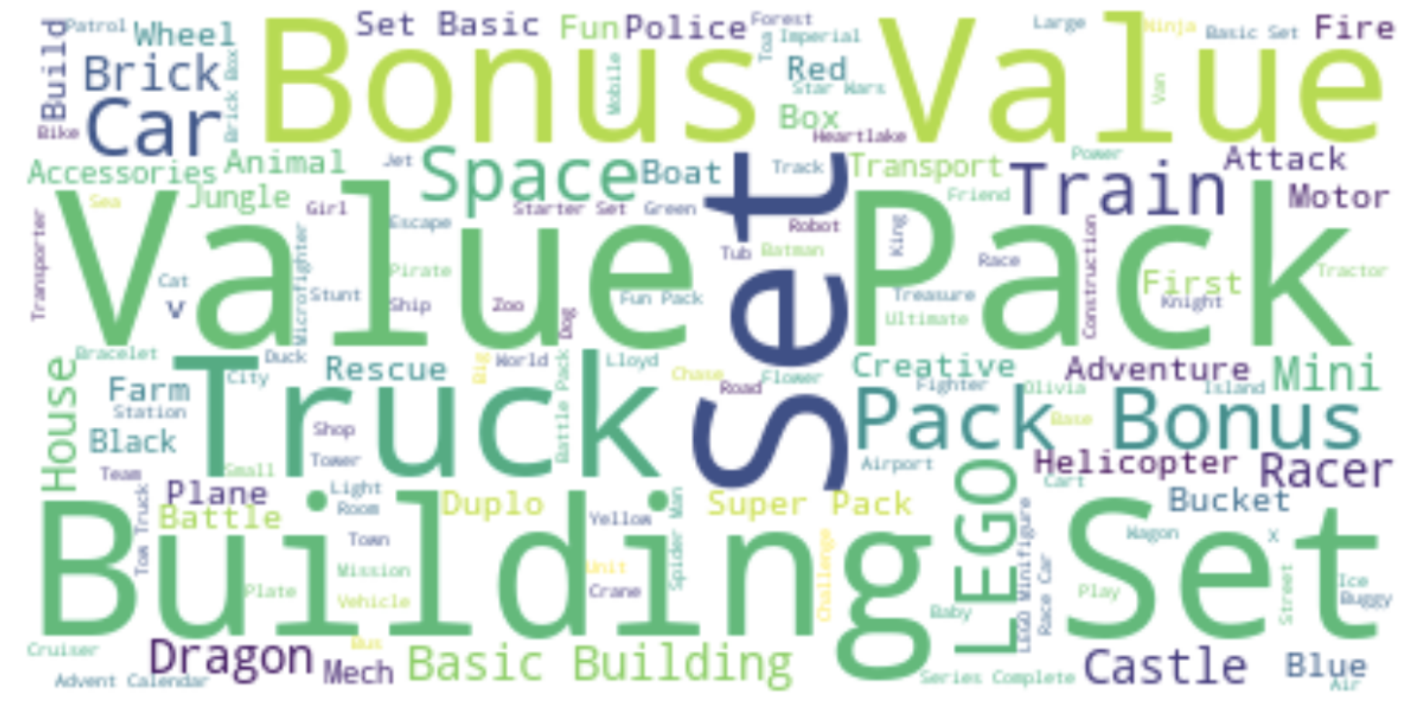
WordCloud by Lego set names

Slide 13
Thank You

